Slide 1
Scientific
Method
Lab Activity #1

Slide 2
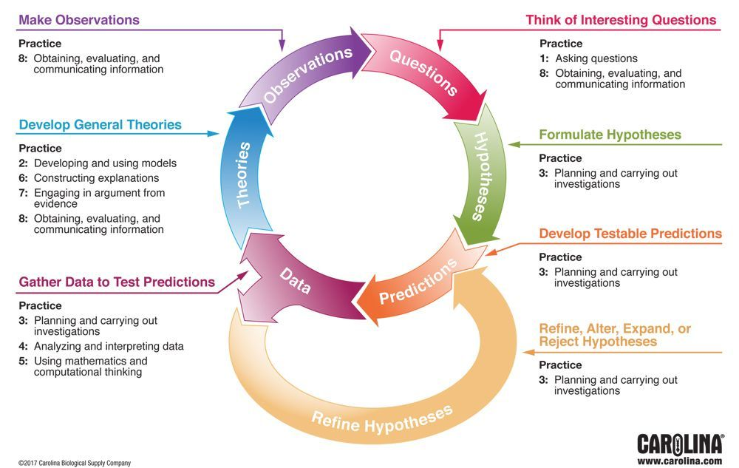
What is the scientific method?

Slide 3
Observation -> Question -> Hypothesis
A general workflow
Observe: I notice that….
Question: How does [observation x] affects [outcome y]?
Hypothesize (when x is categorical):
Null: [Observation x] does not affect [outcome y]
Alternate: [outcome y] is different between groups in [Observation x]
Deeper reflection: [outcome y] is more or less Y in group X of [Observation x]
y
X

Slide 4
Observation -> Question -> Hypothesis
A general workflow
Observe: I notice that….
Question: How does [observation x] affects [outcome y]?
Hypothesize (when x and y are both continuous variables):
Null: [Observation x] does not affect [outcome y]
Alternate 1: [Observation x] has a positive effect on [outcome y]
Alternate 2: [Observation x] has a negative effect on [outcome y]
y
X

Slide 5
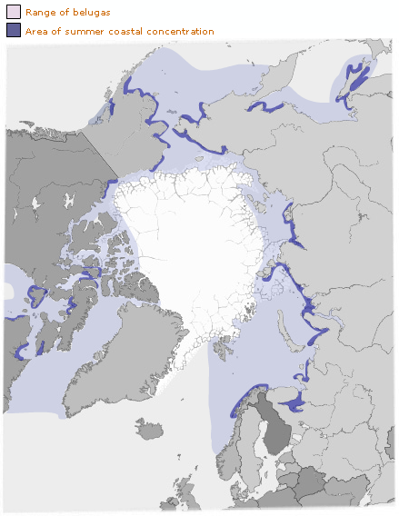
Observation -> Question -> Hypothesis
Practice 1: belugas

Slide 6
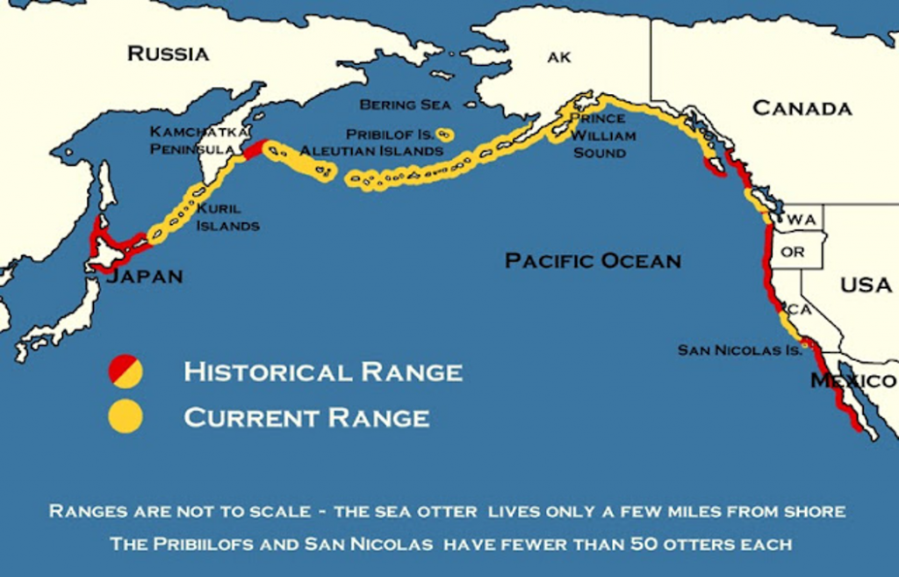
Observation -> Question -> Hypothesis
Practice 2: sea otters

Slide 7
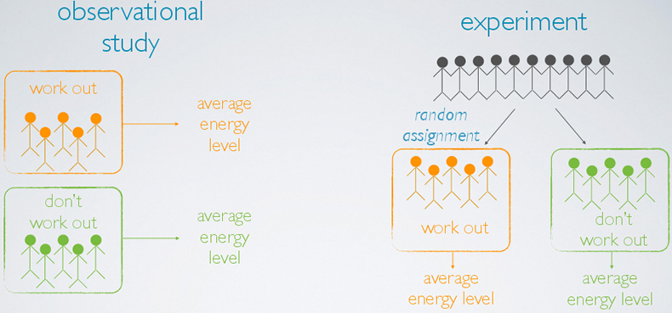
Hypothesis -> Experimental design
A general workflow
Consider:
What are my x and y variables?
What type of data do I need to answer this question?
What other variables might influence my outcome (y)?
Reflect:
What do I know already?
Design:
What are my strata (treatments/groups)?
What are samples within my strata?
How many samples do I need in each group?
How can I randomize across all variables except the one I’m interested in?

Slide 8
Hypothesis -> Experimental design
Practice 1: Beluga whales

Slide 9
Hypothesis -> Experimental design
Practice 2: sea otters
Notes:
Consider: x and y variables, data type, confounding variables
Reflect: what do we already know?
Design: what are strata/samples?, how many samples?, control for variable of interest?

Slide 10
R review:
Tidyverse
Lab Activity #2

Slide 11
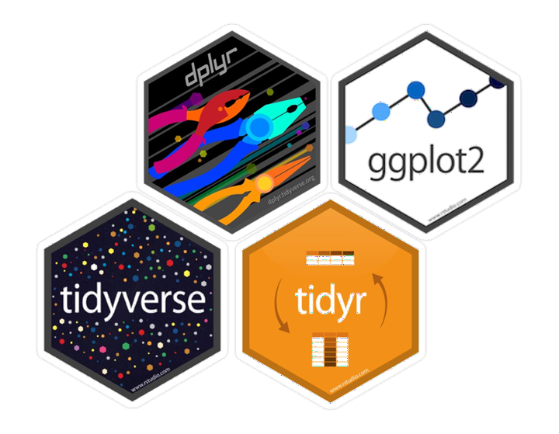
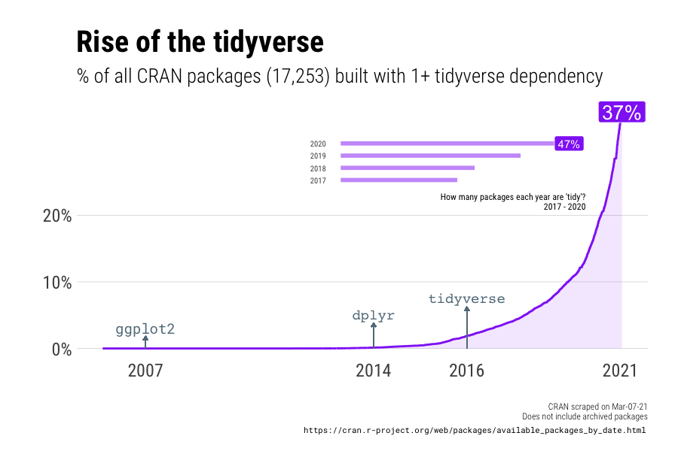
Why tidyverse?
Data analysis should be:
Repeatable
Reproducible
Replicable
Notes:
Repeatable - can I come back to this a year later and do it again?
Reproducible - can someone else use my data and code to produce the same result?
Replicable - can I or someone else use my code with a new dataset to compare results?

Slide 12
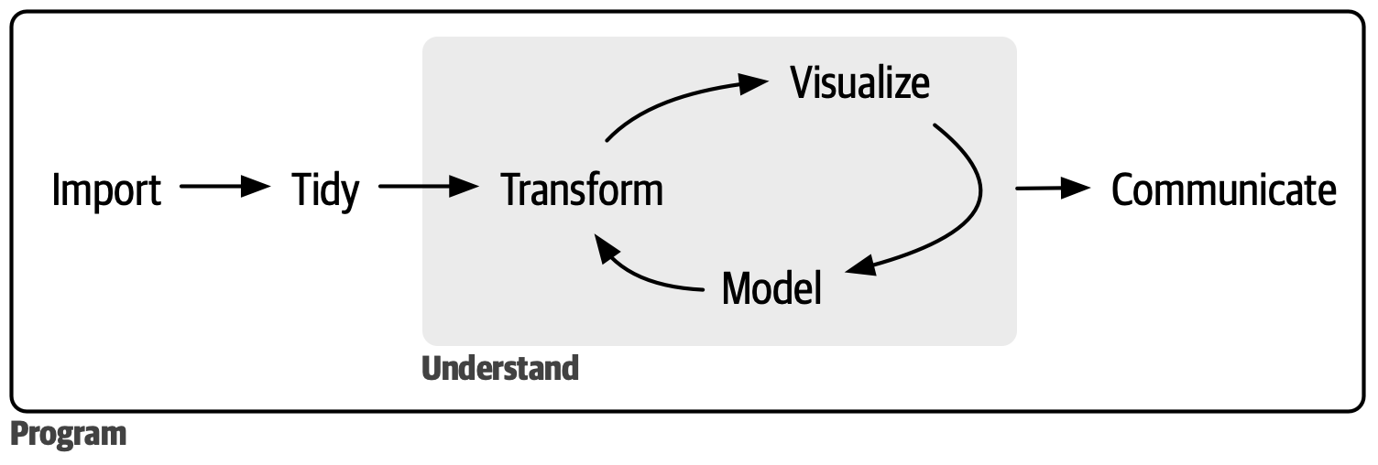
What is the Data science workflow?

Slide 13
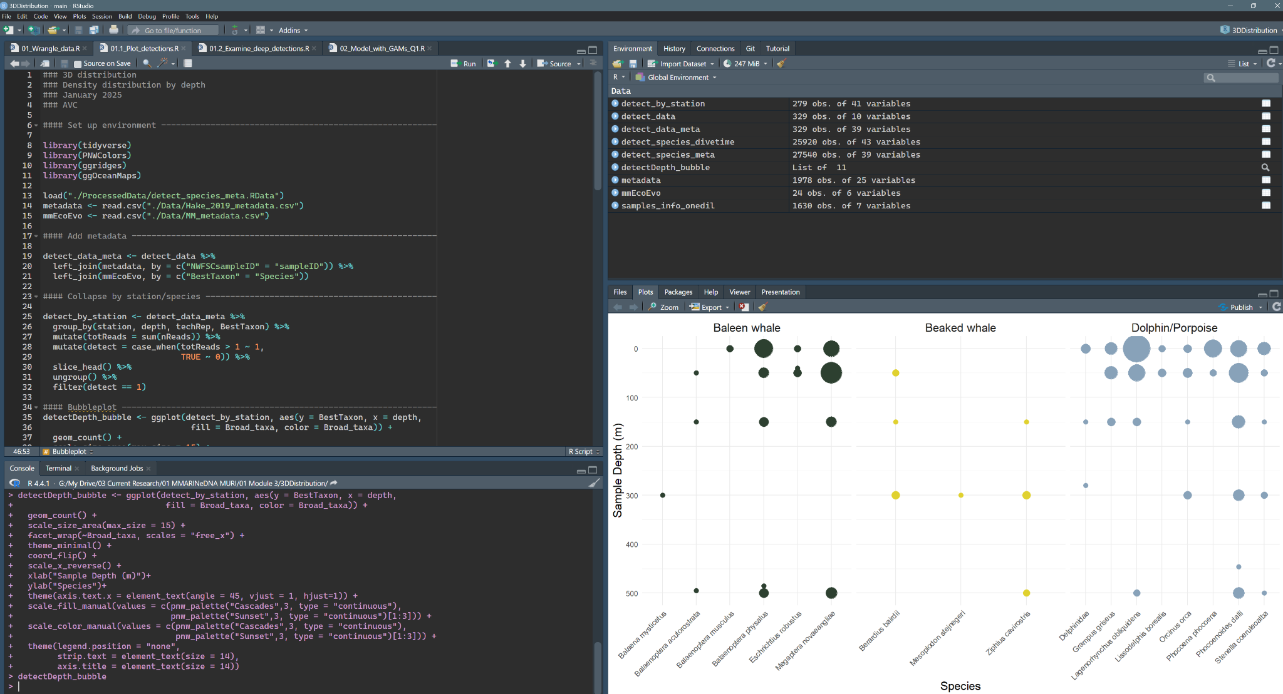
Getting to Know Rstudio
Console
Scripts/Viewer
Environment
Plots/help

Slide 14
Activity: Tidyverse tutorial

Slide 15
Population structure in Pilot whales
Lab Activity #3

Slide 16
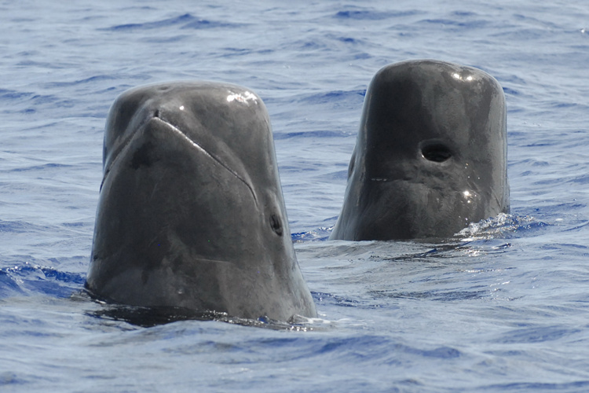
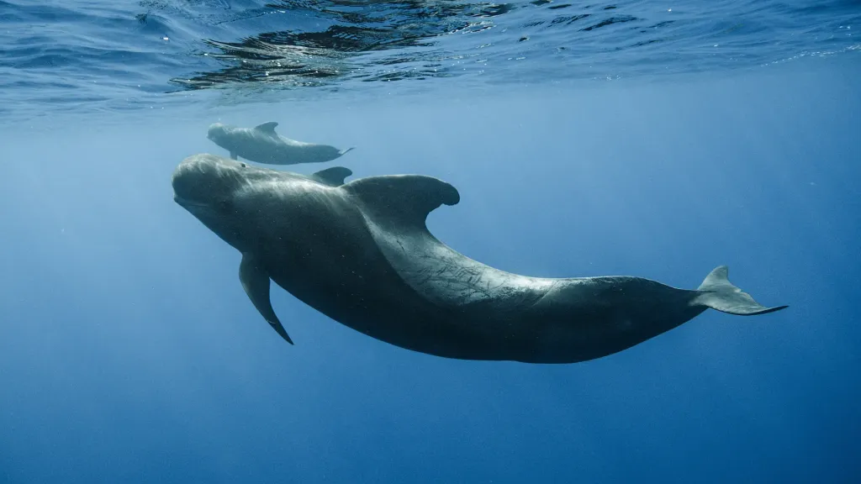
background
Notes:
Gregarious, often observed in groups of 15-30
Deep-divers, eat squid at 800+ meters
Any questions?
What about the babies?

Slide 17
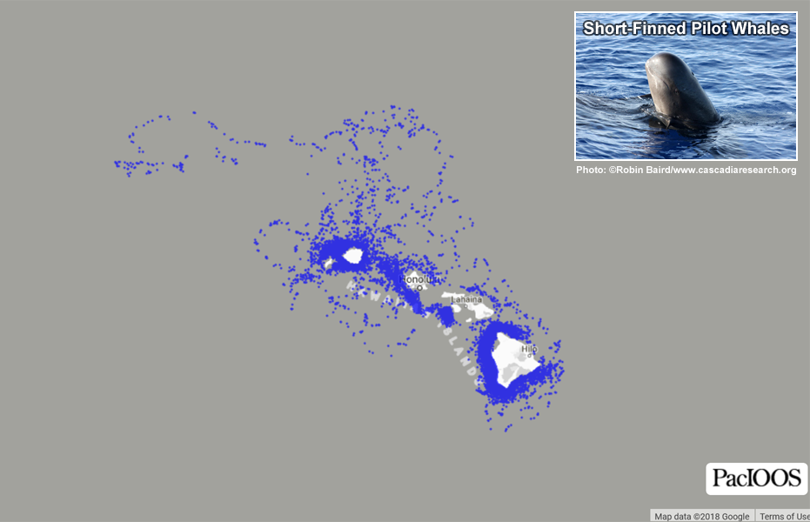
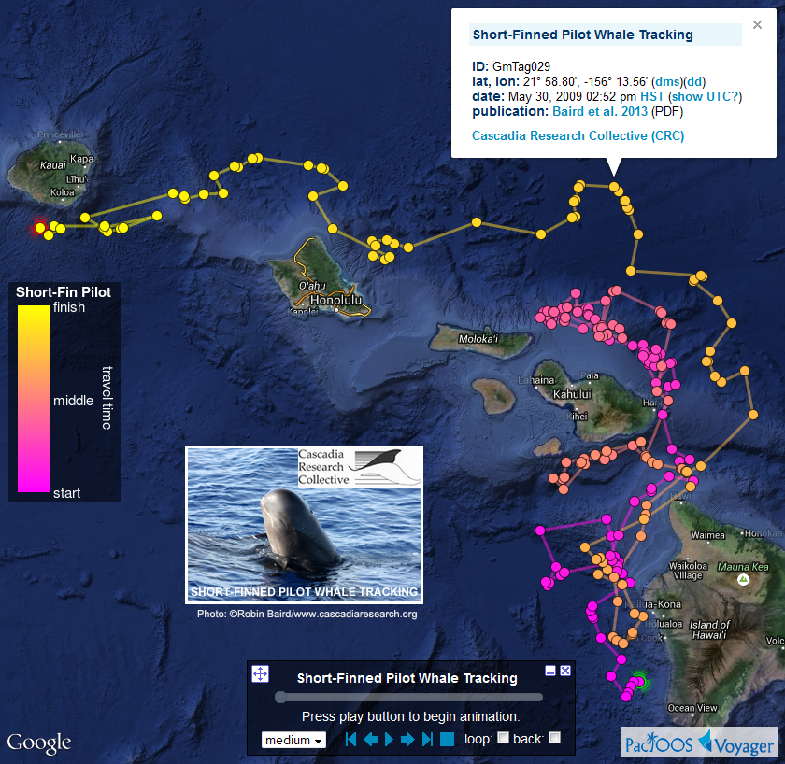
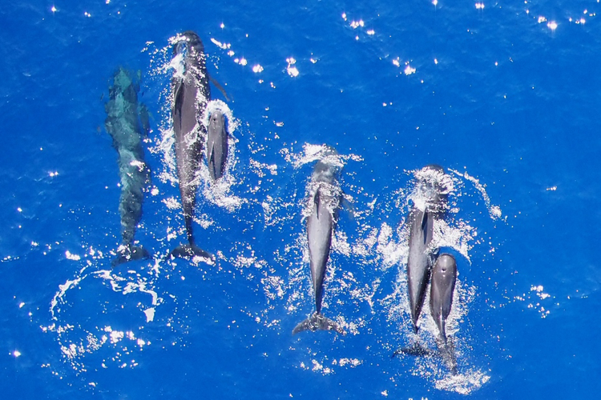
distribution
Notes:
What do you notice?

Slide 18
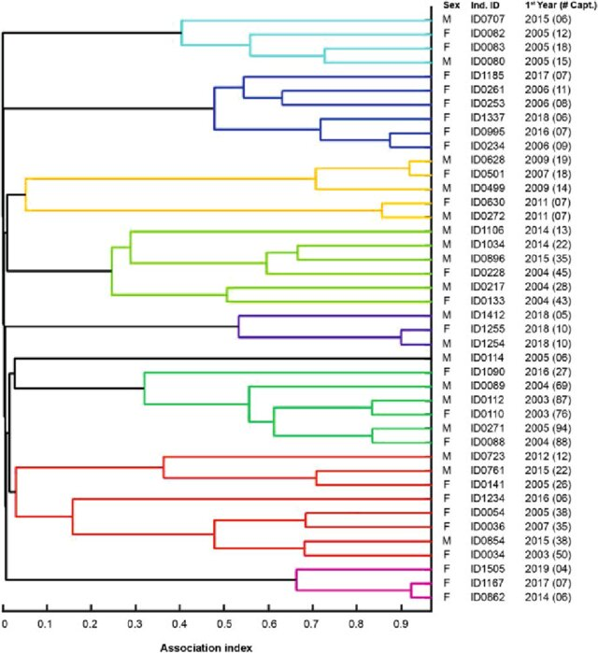
associations
Notes:
What do you notice?

Slide 19
Step 01: start a script
Set up your working environment:
[load libraries] library(tidyverse)
Use comments to keep clear notes!

Slide 20
Step 02: write hypotheses
[null hypothesis] H0:
[alternative 1a] H1a:
[alternative 1b] H1b:

Slide 21
Step 03: load data
read_csv()

Slide 22
Step 04: wrangle and plot
[wrangle] my_data %>%
filter()
pivot_longer() (or wider)
mutate()
separate() (or unite)
[plot] ggplot() +
geom_point() (or line, smooth, bar, etc)
theme_classic() (or bw, minimal, etc)
xlab(), ylab()
ggtitle()

Slide 23
Step 05: model
ANOVA: aov()
Linear regression: lm()
Chi-square test: chisq.test()

Slide 24
Lab Reflection: What does this data tell you about population structure in Hawaiian short-finned pilot whales?
Include your null and alternative hypotheses, and at least one plot you made today.
Describe their population structure in terms of the evolutionary processes we learned about this week.
Be brief! <1 page please

